Slide 1




Metro Design
101
Clean, clear, to the point

Slide 2

Who am I?
What I do!

Slide 3
Agenda
Introduction
What is Metro?
General Metro design stuff
Windows 8 stuff
Windows Phone 7 stuff
Designing Metro apps

Slide 4
A short video

Slide 5
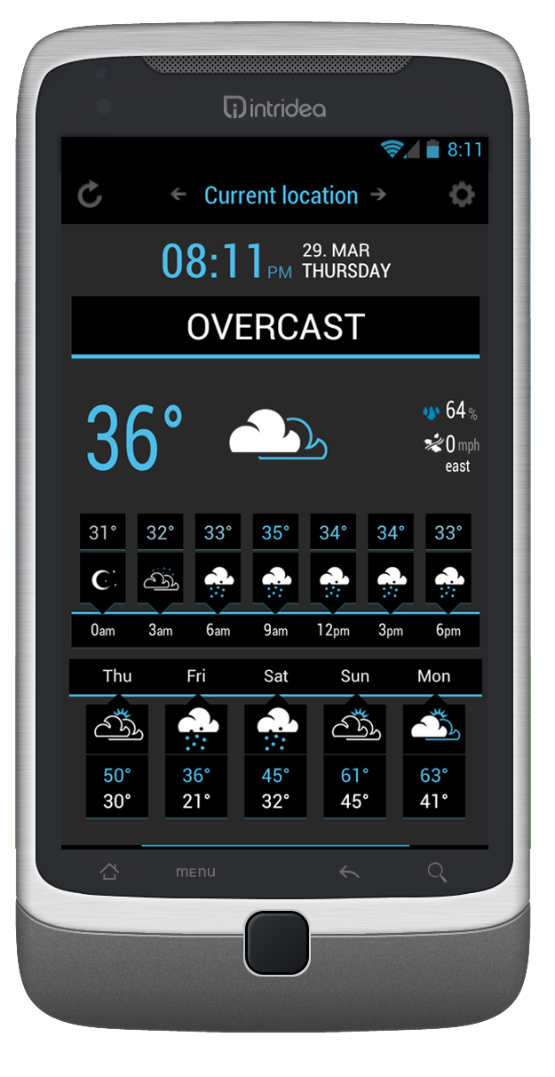
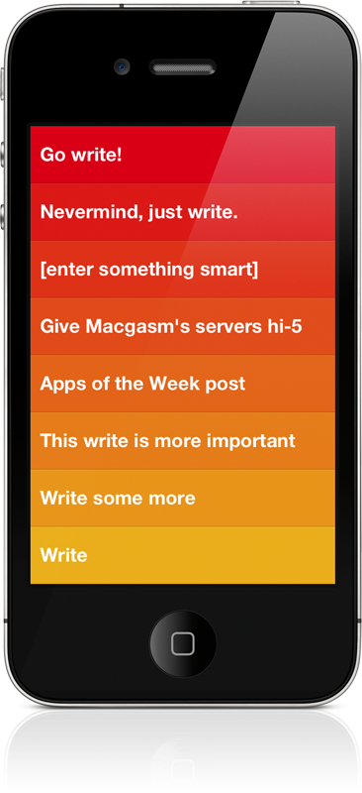
WeatherFlow
Clear

Slide 6
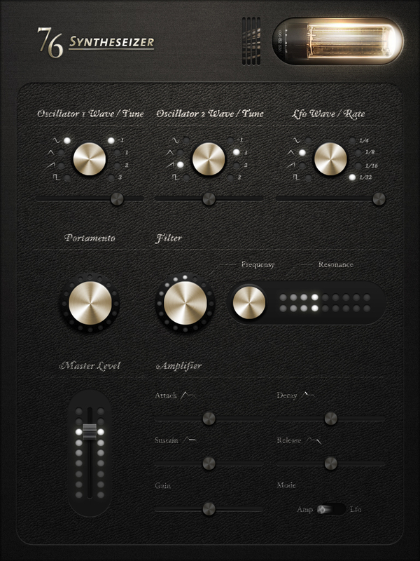
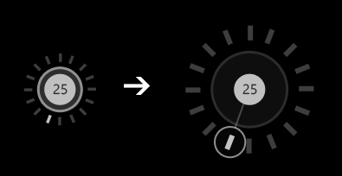

Realistic vs digital

Slide 7
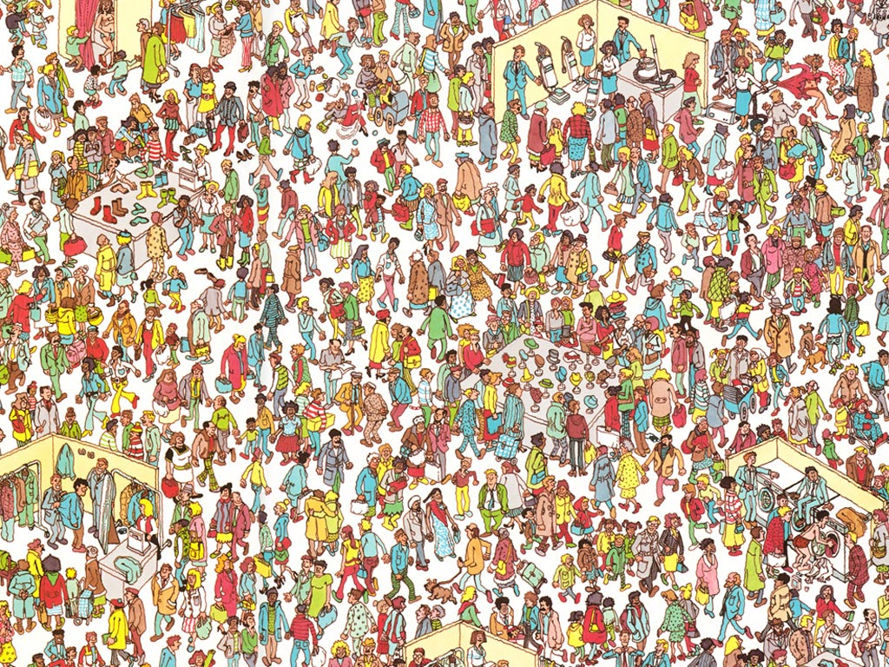
Stand out from the crowd

Slide 8
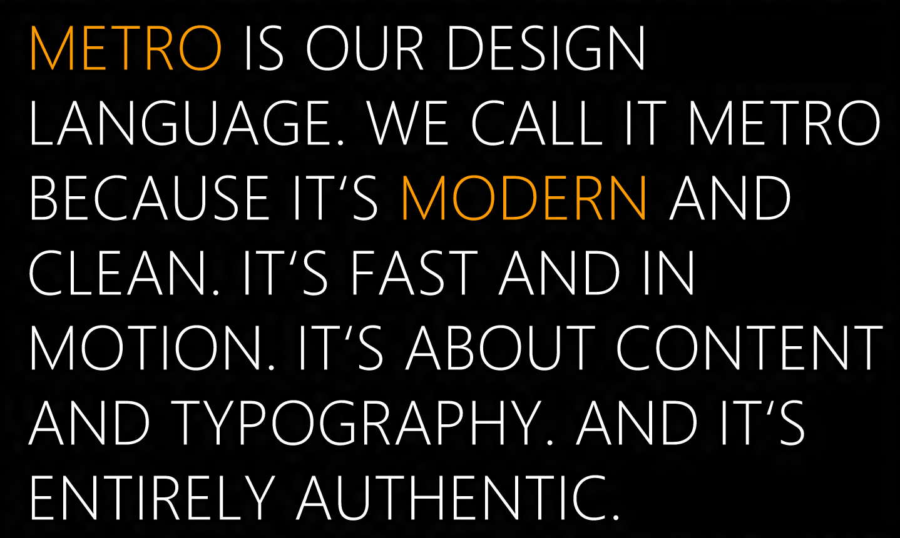

Slide 9
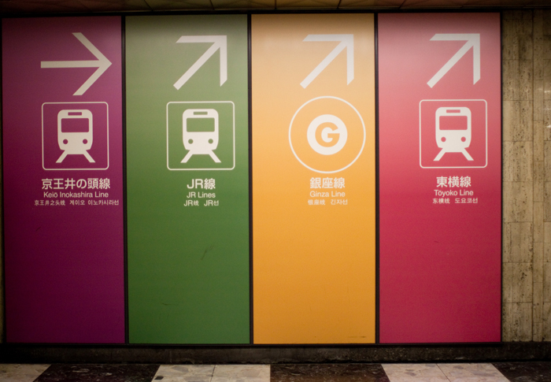

Slide 10

Designing a Metro app

Slide 11
Type Ramp
42pt
11pt
20pt
9pt
Semibold
Bold
Regular
Semibold
Bold
Regular
Regular
Semilight
Light
Semilight
Light

Slide 12
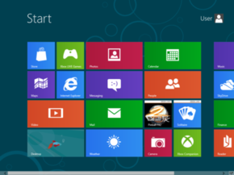
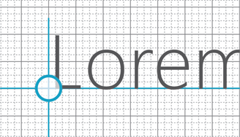
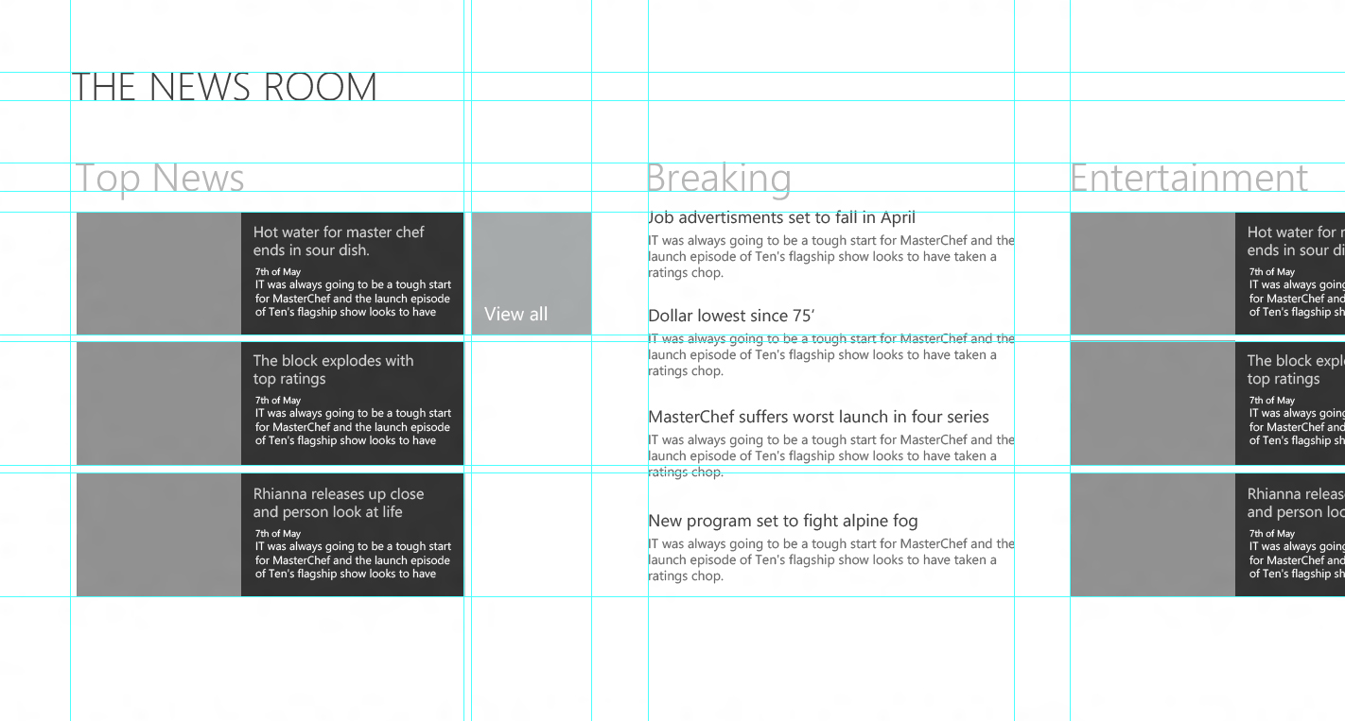
Grids

Slide 13

Themes, colours, sans gradients

Slide 14
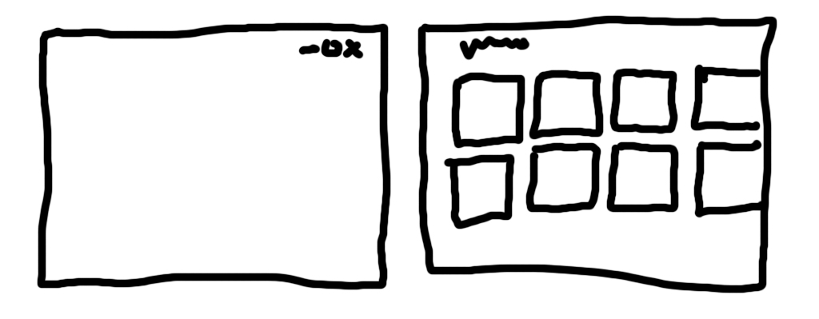
No Chrome

Slide 15
Animation!
Purposeful, lively, adhesive
Direct manipulation

Slide 16
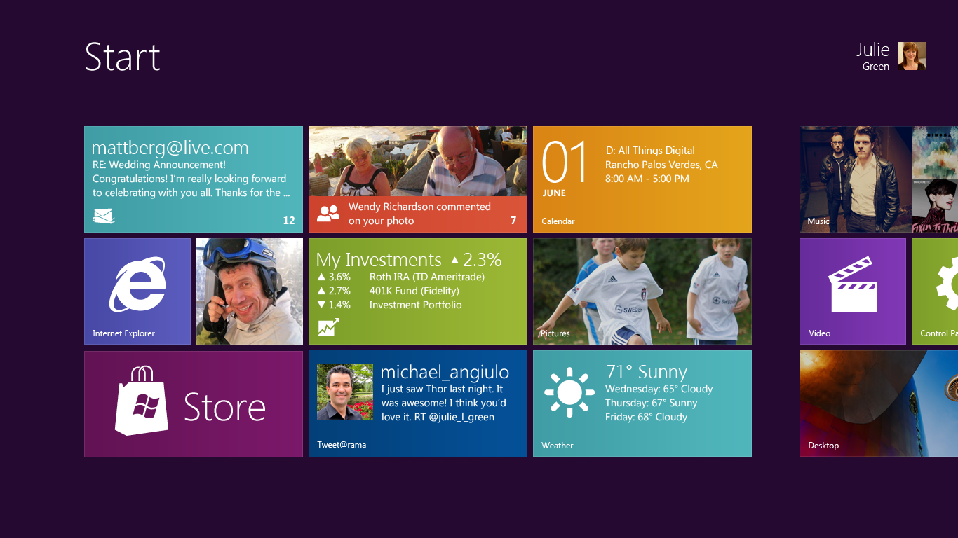
Windows 8

Slide 17
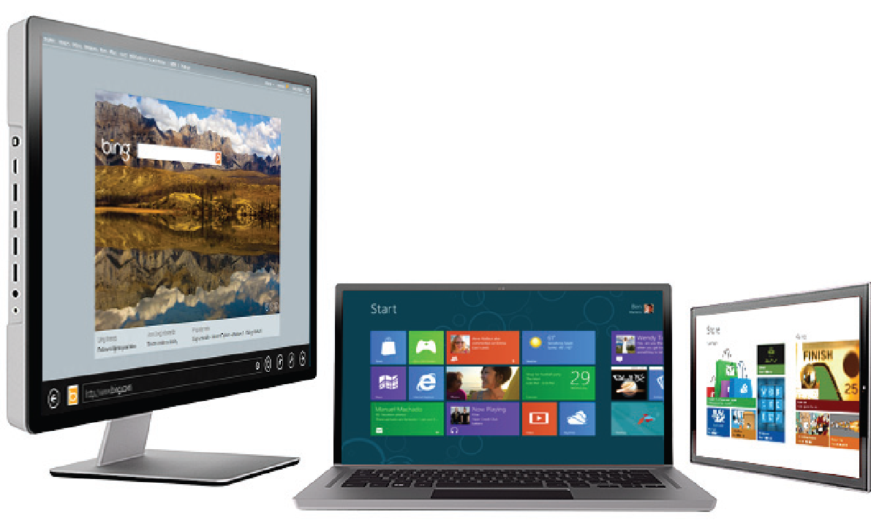
Screen size

Slide 18
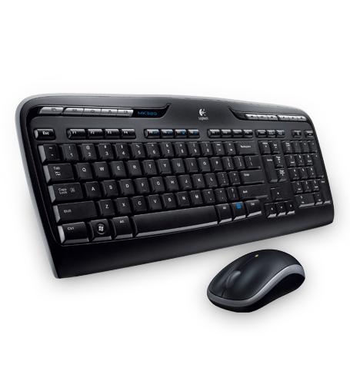
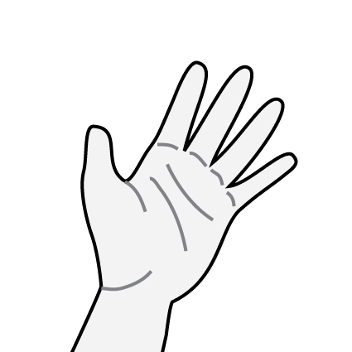
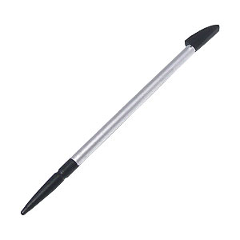
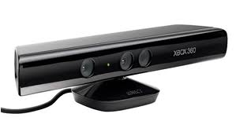


Interaction
Common
Possible

Slide 19



App bars, Charms & Contracts

Slide 20
New Views!
Portrait, landscape, semantic, snapped.

Slide 21
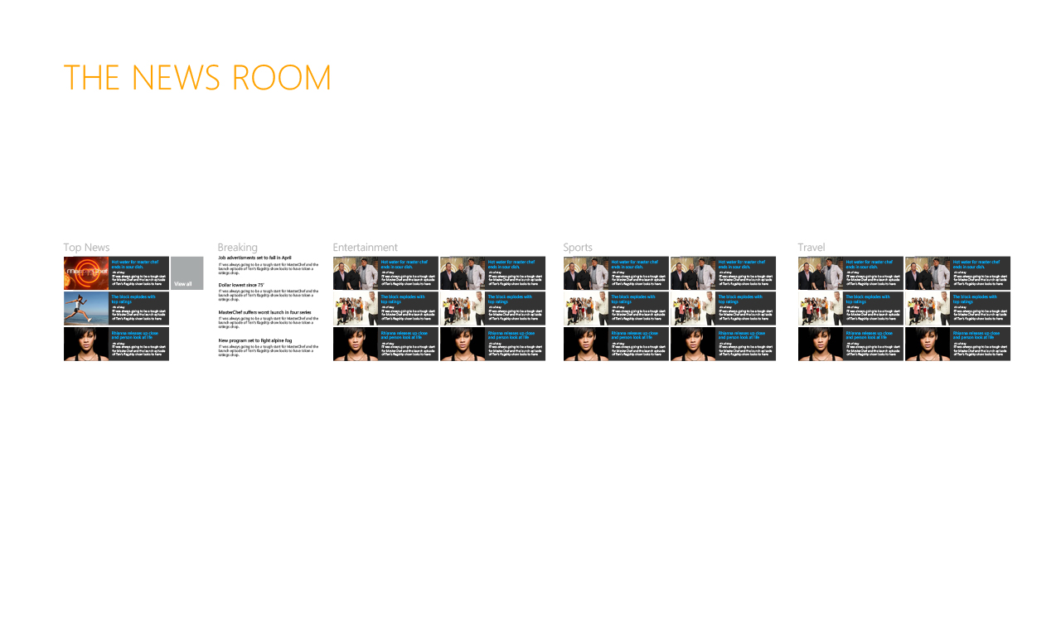
Semantic Zoom

Slide 22
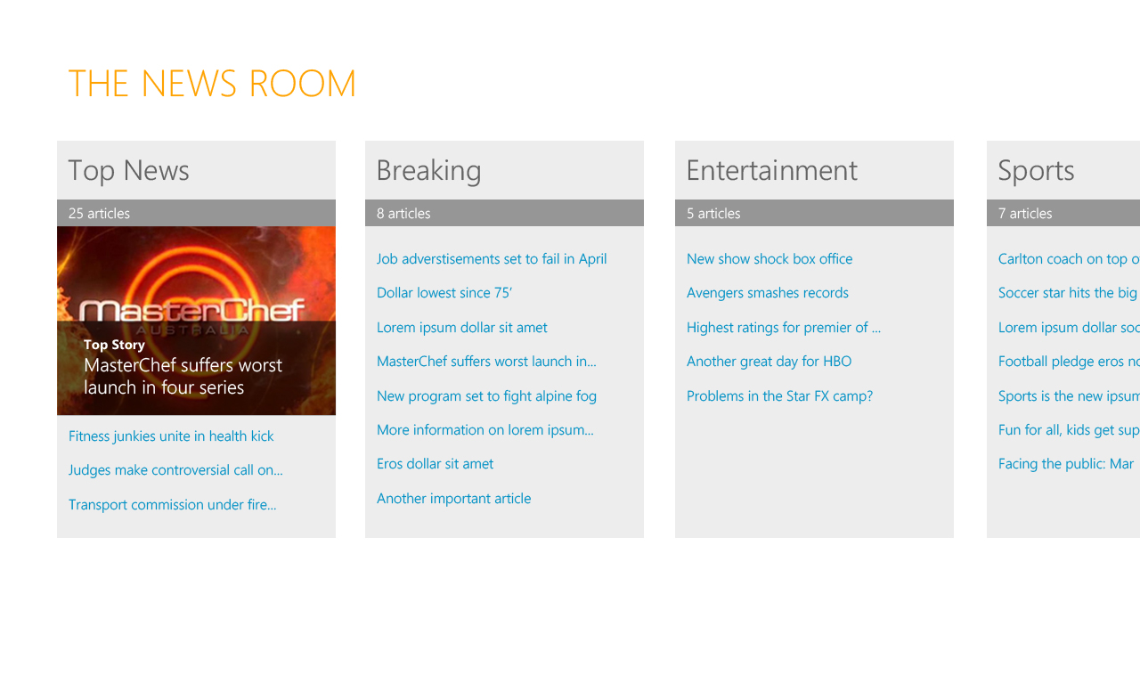
Semantic Zoom

Slide 23

Snapped View

Slide 24
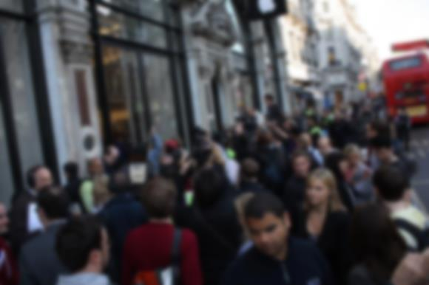
On the move

Slide 25
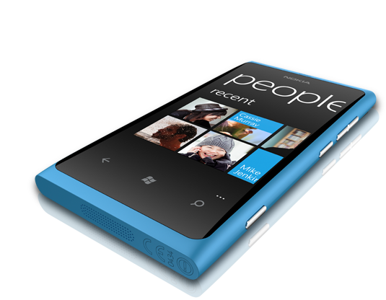
Windows Phone 7

Slide 26
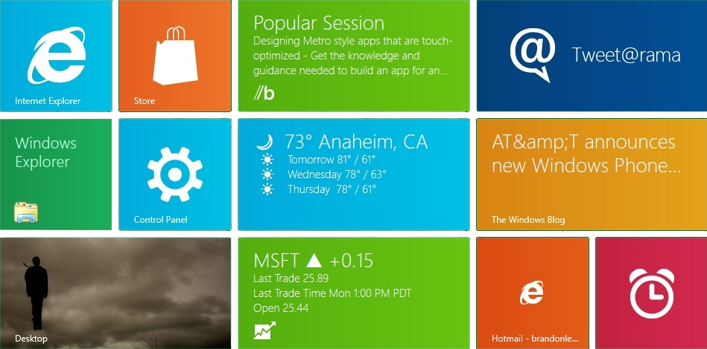
Tiles!

Slide 27
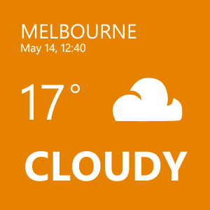
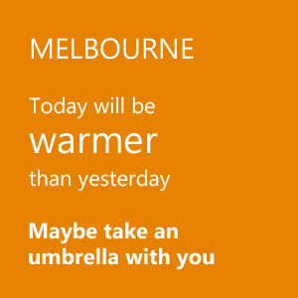

Slide 28
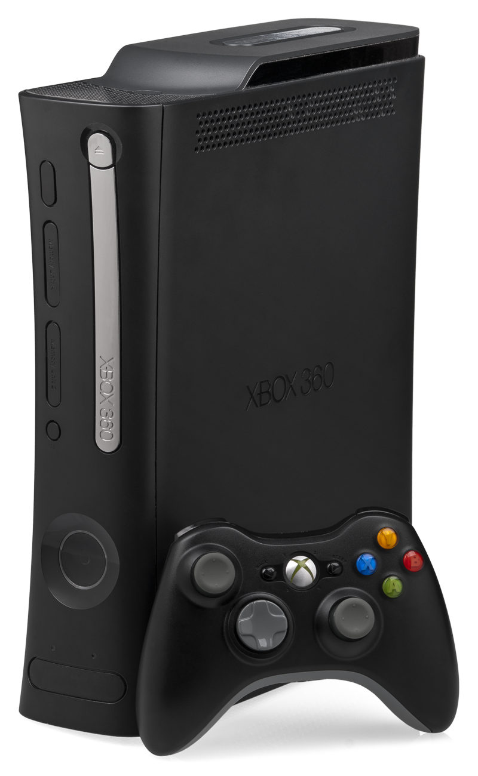
Xbox

Slide 29
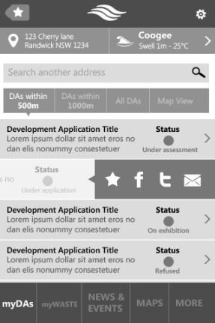
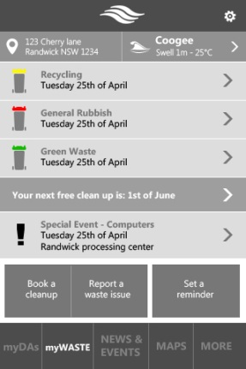
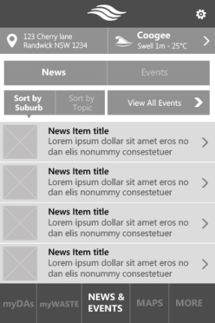
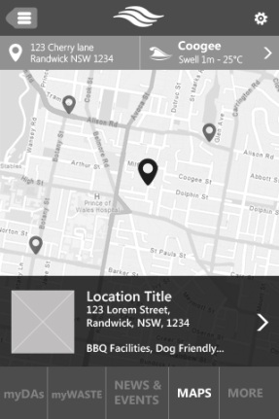
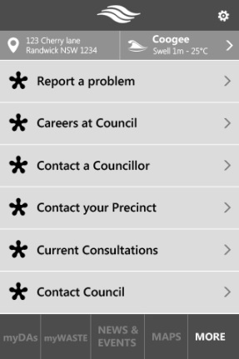
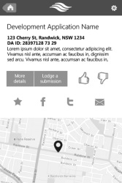
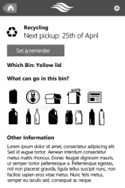
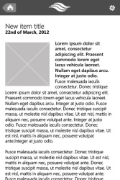
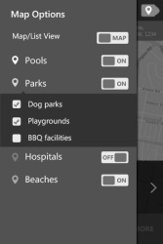
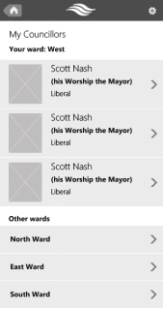
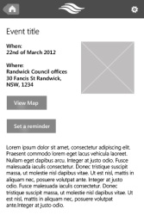
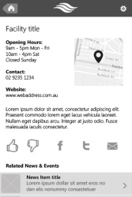
Design your content
Application launch

Slide 30
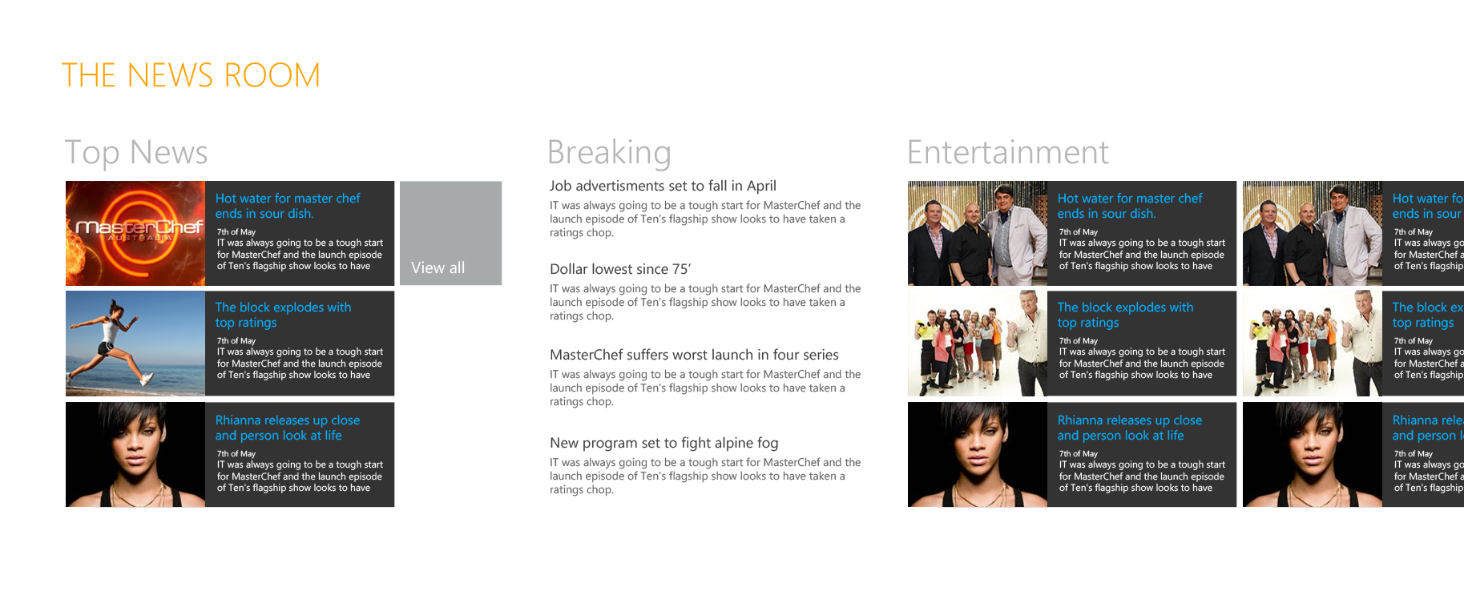
The guidelines

Slide 31
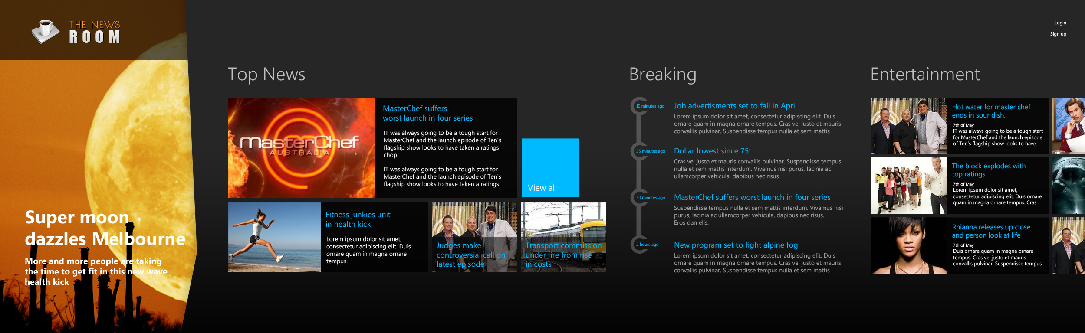
Room to move

Slide 32
Thanks!
@agkdesign alex@xamling.net

